Slide 1
Murun hurgelt

Slide 2
Murun hurgelt
What is murun hurgelt
Murun hurgekt is bullshit

Slide 3
Murun hurgelt
What is murun hurgelt
Murun hurgekt is bullshit

Slide 4

Murun hurgelt
What is murun hurgelt
Murun hurgekt is bullshit
Murun hurgelt
Мөрөн хүргэлт

Slide 5
Murun hurgelt
What is murun hurgelt
Murun hurgekt is bullshit
Мөрөн хүргэлт

Slide 6



Murun hurgelt
What is murun hurgelt
Murun hurgekt is bullshit
Мөрөн хүргэлт

Slide 7



Murun hurgelt
What is murun hurgelt
Murun hurgekt is bullshit
Мөрөн хүргэлт

Slide 8
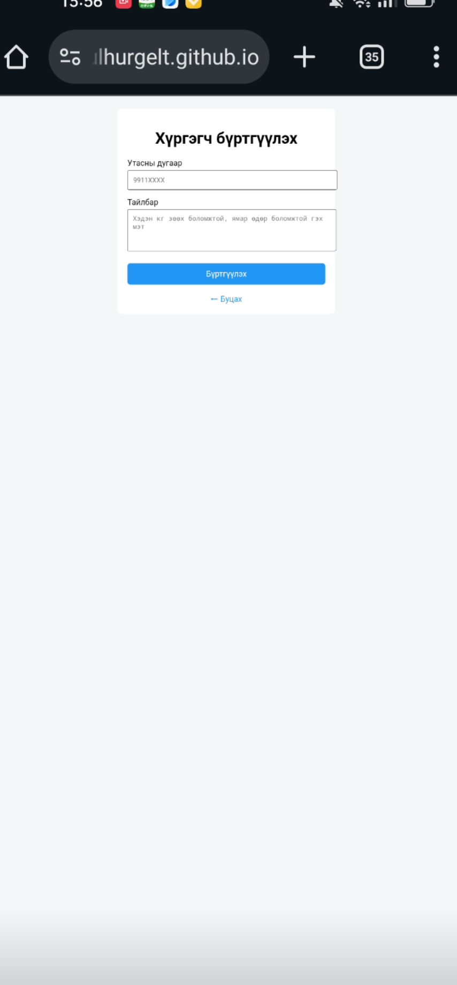
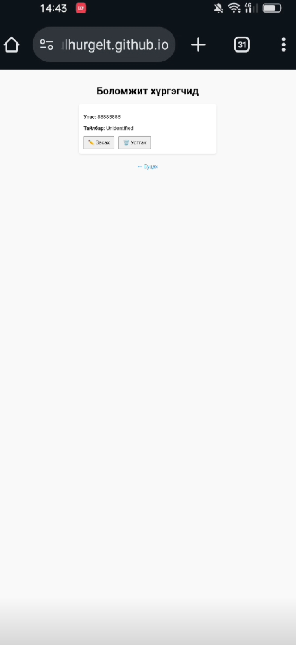
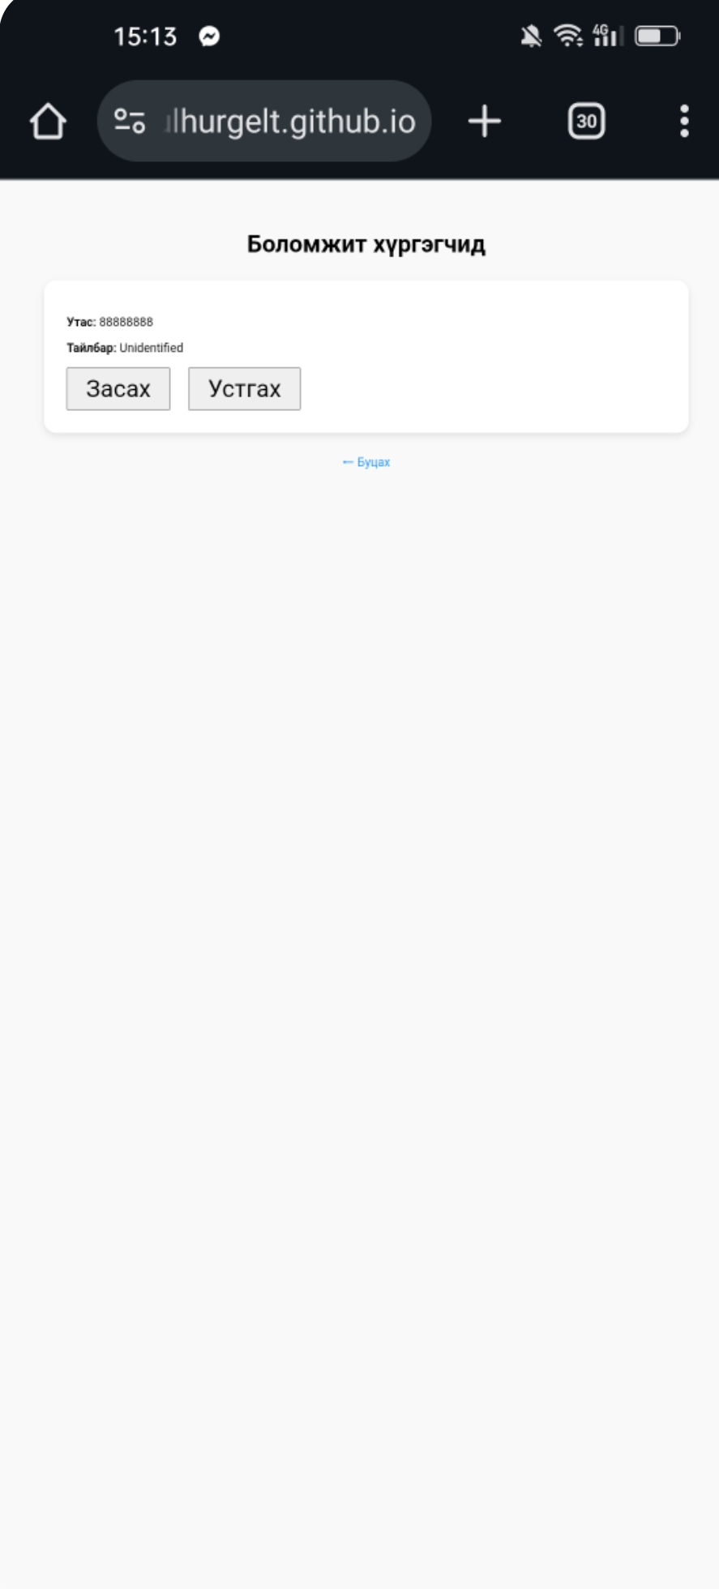
Murun hurgelt
What is murun hurgelt
Murun hurgekt is bullshit
Мөрөн хүргэлт

Slide 9
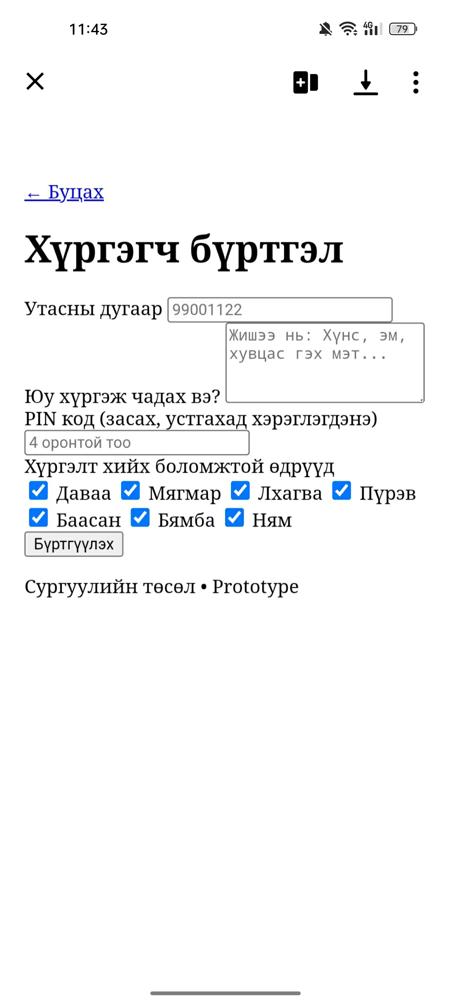
Murun hurgelt
What is murun hurgelt
Murun hurgekt is bullshit
Мөрөн хүргэлт

Slide 10
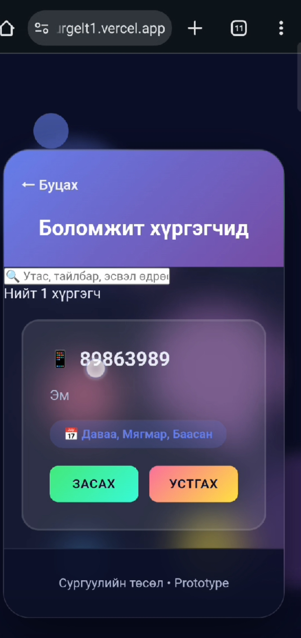
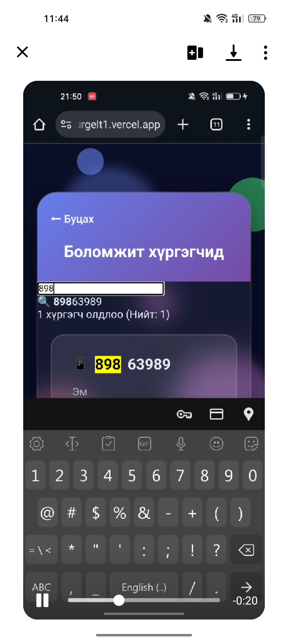
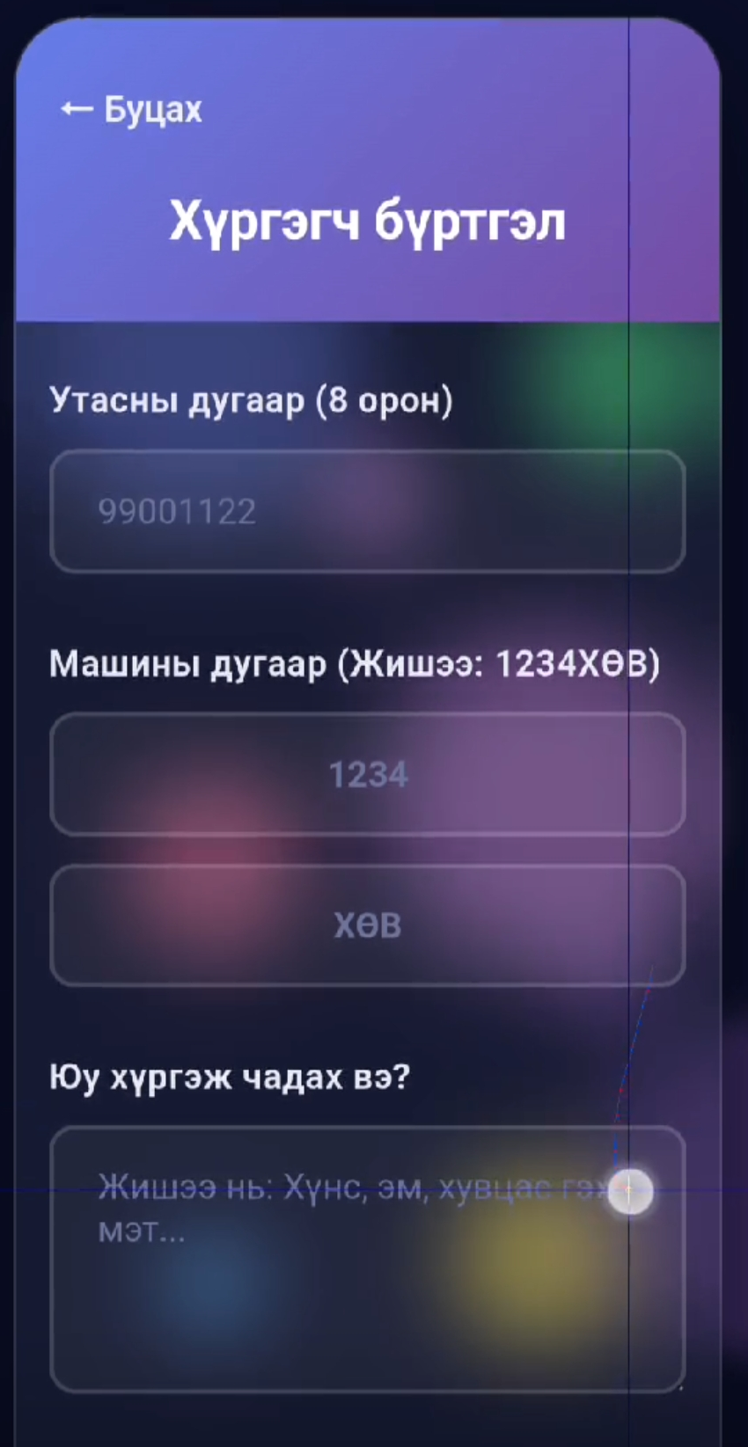
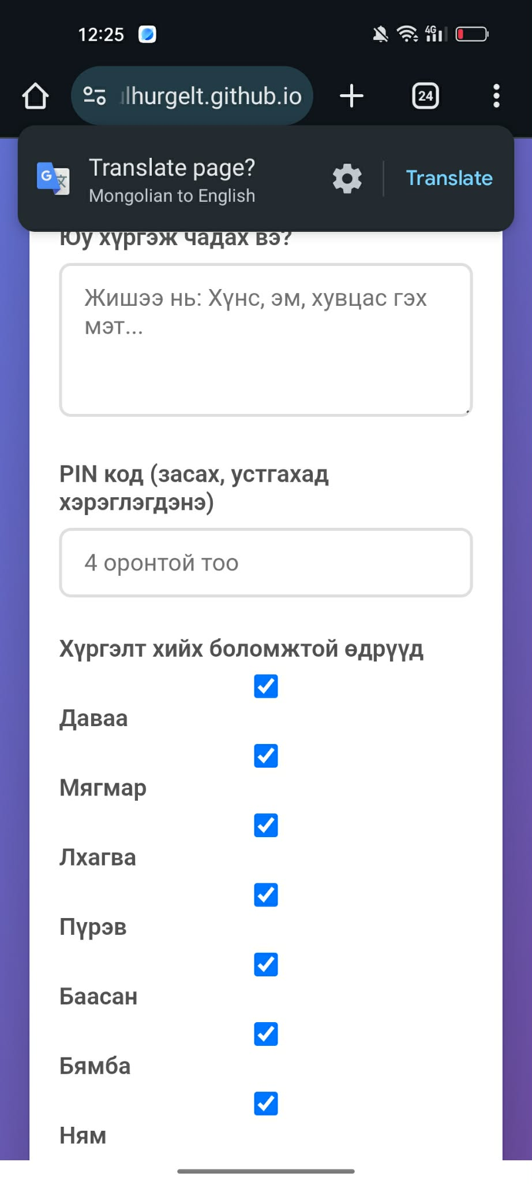
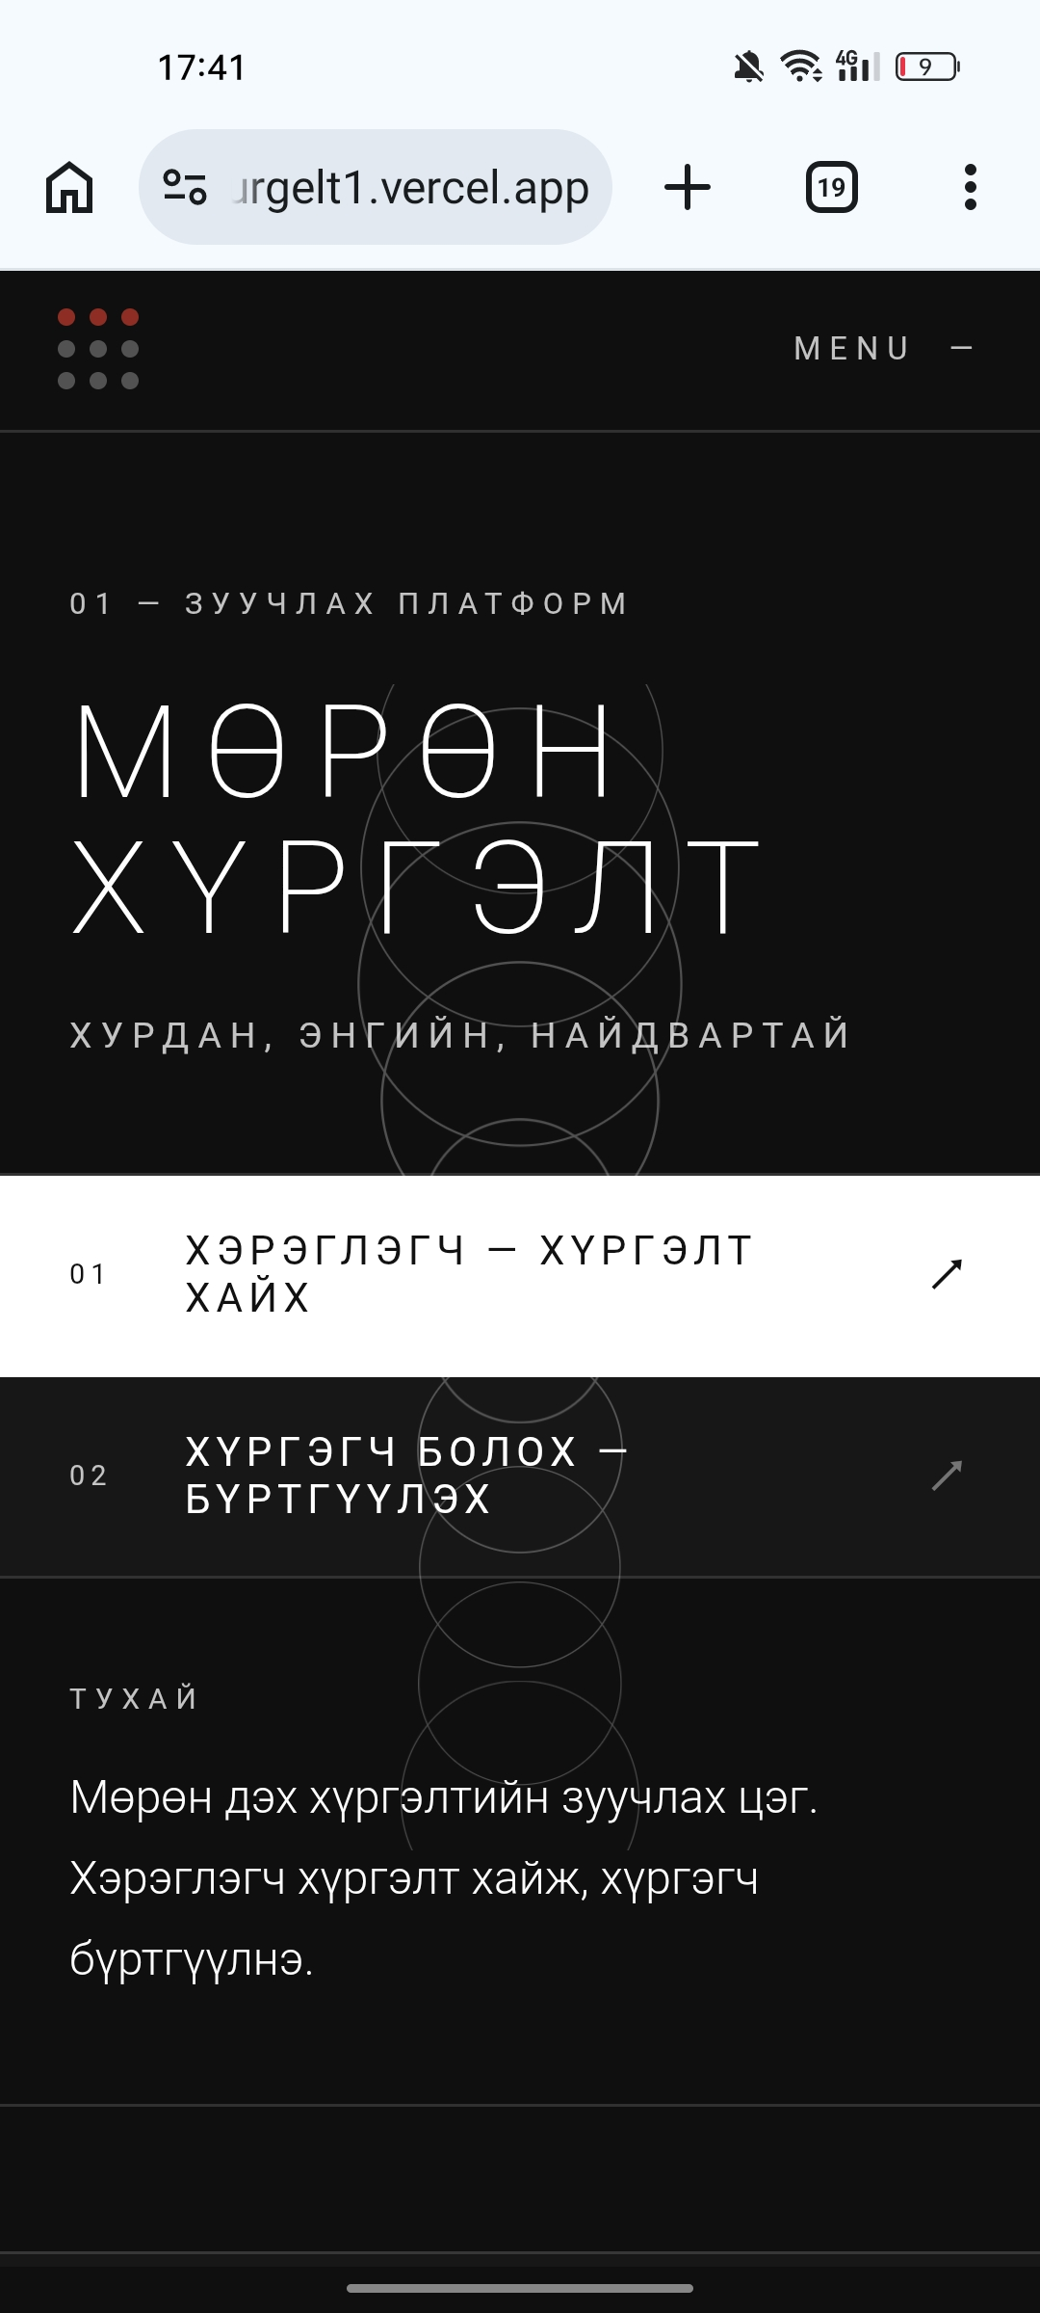
Murun hurgelt
What is murun hurgelt
Murun hurgekt is bullshit
Мөрөн хүргэлт

Slide 11
Murun hurgelt
What is murun hurgelt
Murun hurgekt is bullshit
Мөрөн хүргэлт

Slide 12
Murun hurgelt
What is murun hurgelt
Murun hurgekt is bullshit
Мөрөн хүргэлт

Slide 13
Murun hurgelt
What is murun hurgelt
Murun hurgekt is bullshit
Мөрөн хүргэлт

Slide 14
Murun hurgelt
What is murun hurgelt
Murun hurgekt is bullshit
Мөрөн хүргэлт

Slide 15
Murun hurgelt
What is murun hurgelt
Murun hurgekt is bullshit
Мөрөн хүргэлт

Slide 16
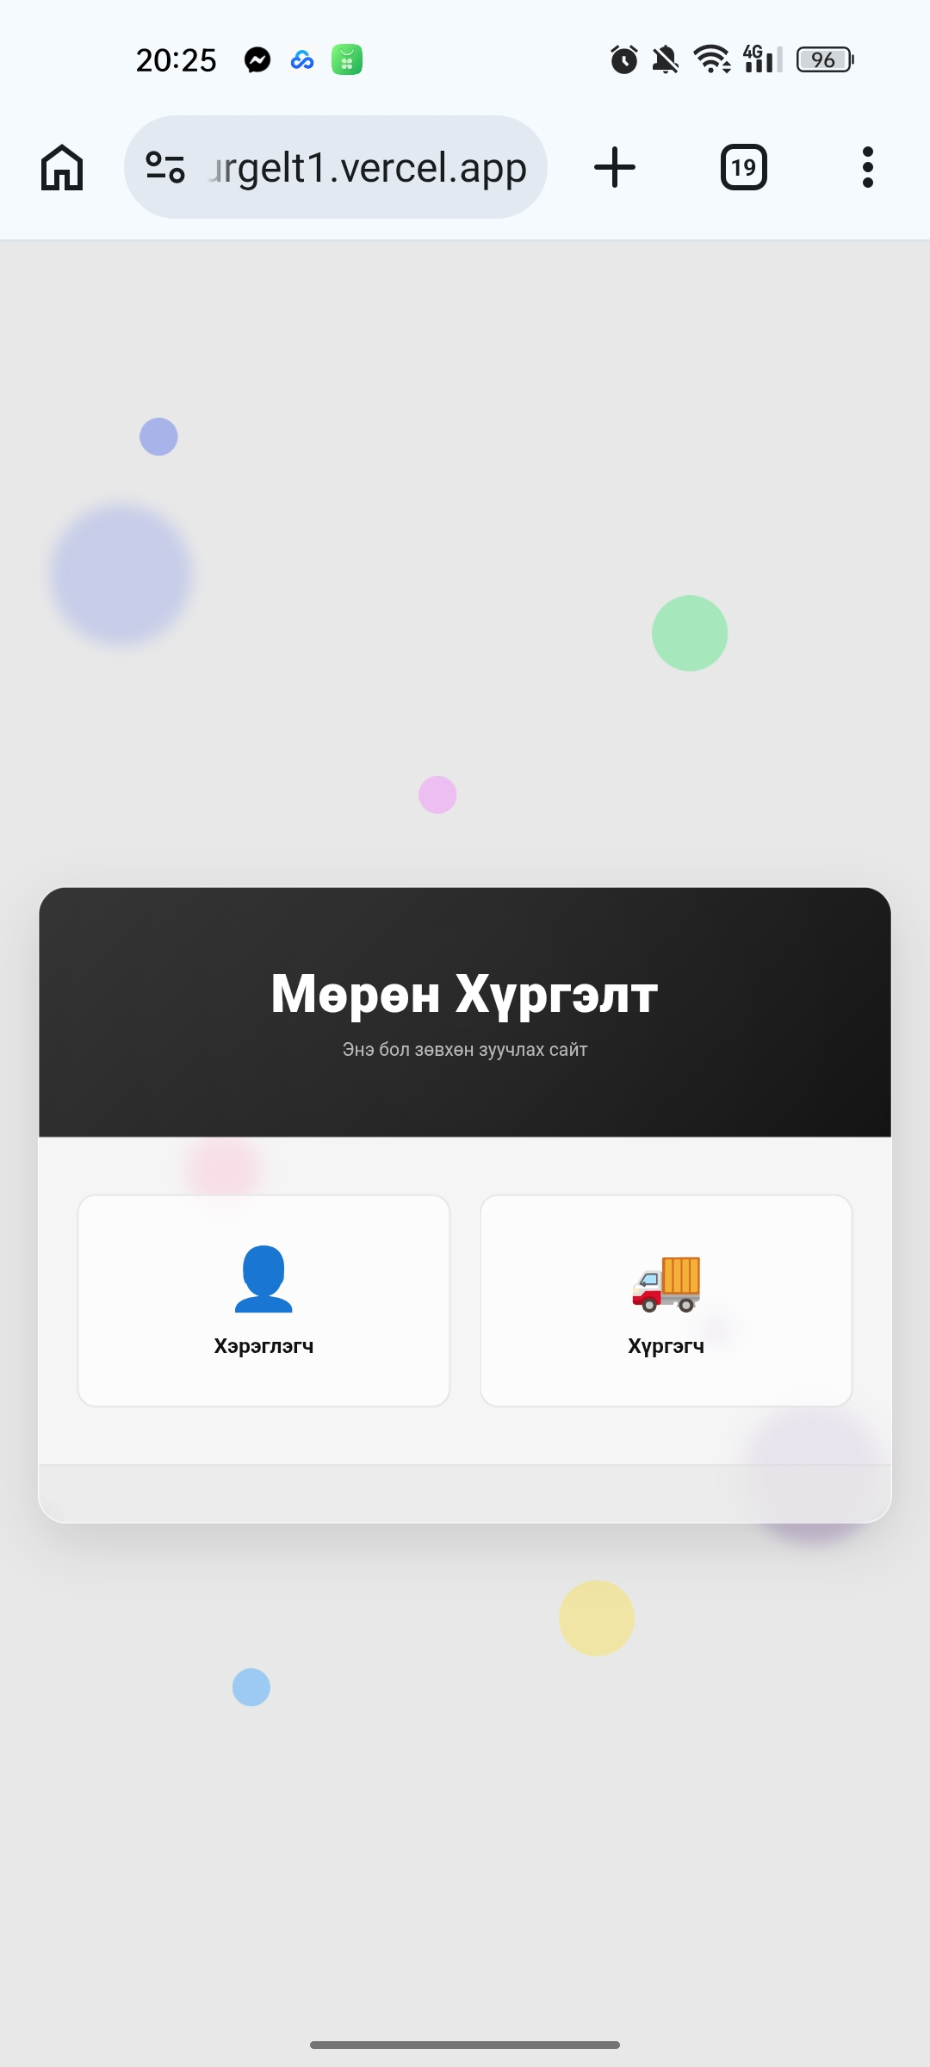
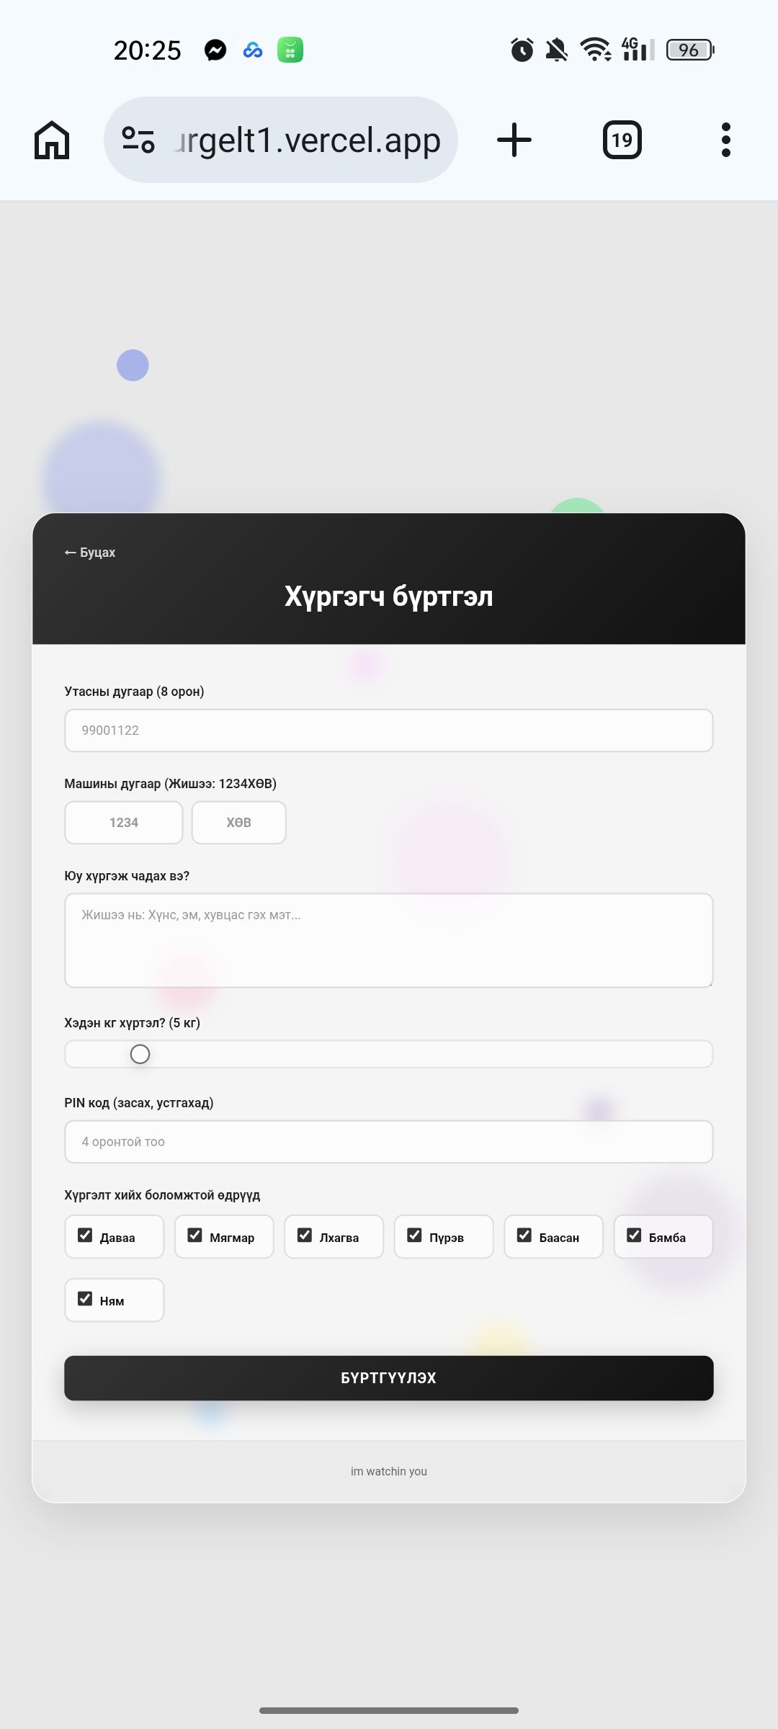
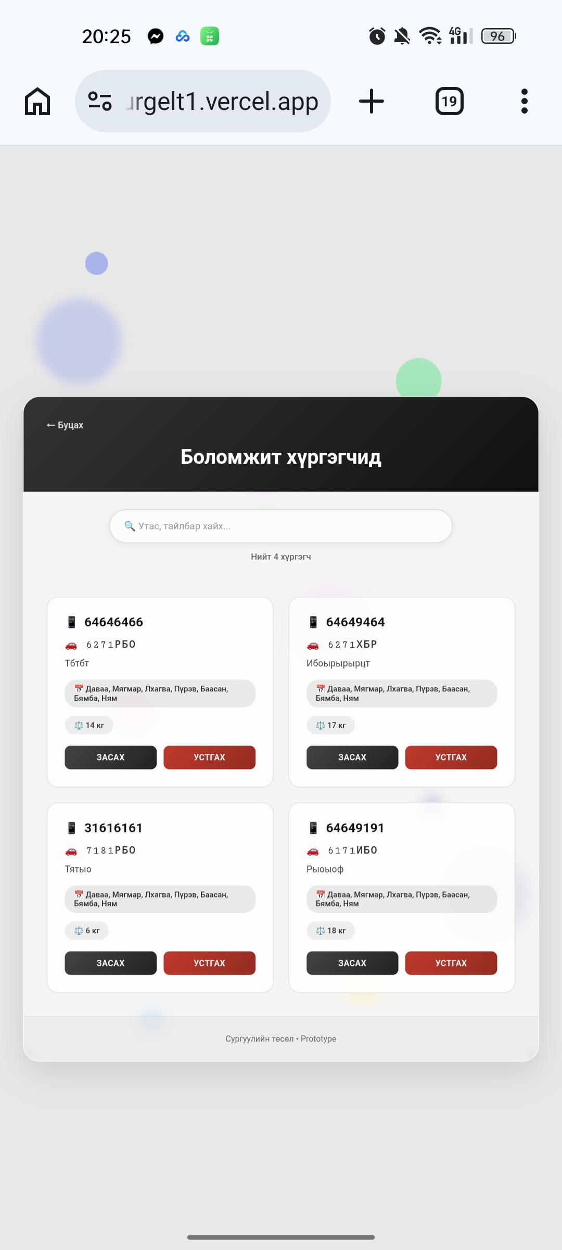
Murun hurgelt
What is murun hurgelt
Murun hurgekt is bullshit
Мөрөн хүргэлт

Slide 17
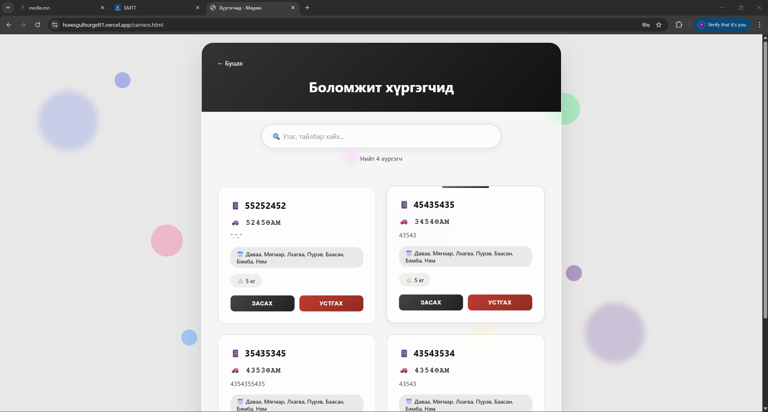
Murun hurgelt
What is murun hurgelt
Murun hurgekt is bullshit
Мөрөн хүргэлт

Slide 18
Murun hurgelt
What is murun hurgelt
Murun hurgekt is bullshit
Мөрөн хүргэлт

